Slide 1

Choosing a place to live in Rio de Janeiro during the COVID-19 Pandemic
Brasília, April 2nd, 2021
Romeu Ribeiro Marques da Fonseca

Slide 2
Introduction
How to choose a safe place to live in Rio de Janeiro during the COVID-19 pandemic?
Criterion of a safe place: Low death rate neighborhood with good medical infrastructure
The quantity of hospitals, emergency rooms and urgent care centers, obtained via the Foursquare API, will be used to determine the medical infrastructure of the region

Slide 3
Data Source
The medical location will come from the Foursquare API. The geospatial and COVID-19 data will come from the local government repository:
http://dadosabertos.rio.rj.gov.br/apiUrbanismo/apresentacao/csv/bairros_.csv
https://www.data.rio/datasets/cep-dos-casos-confirmados-de-covid-19-no-munic%C3%ADpio-do-rio-de-janeiro
https://www.data.rio/datasets/limite-de-bairros?geometry=-44.899%2C-23.138%2C-41.992%2C-22.695 (The geoson file with the neighborhood limits)

Slide 4
Methodology
Data cleansing and merging all the information in a single dataframe
New dataframe with all the medical venues
Clustering the neigborhoods in 3 groups, using the K-Means algorithm – using the medical venues as features
Inspect all the clusters and its relationship with the COVID-19 Death Rate
Analyze the final result, via a Choropleth Map

Slide 5
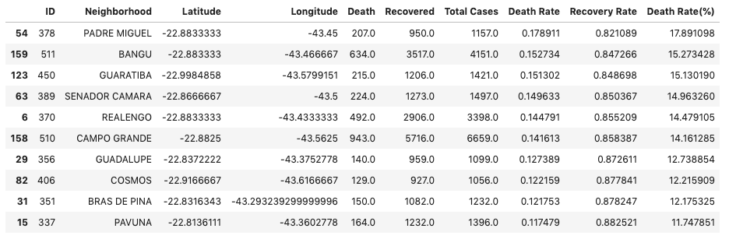
Exploratory Data Analysis
Top Ten regions with more than 1000 cases of COVID-19,
ordered by its death rate

Slide 6
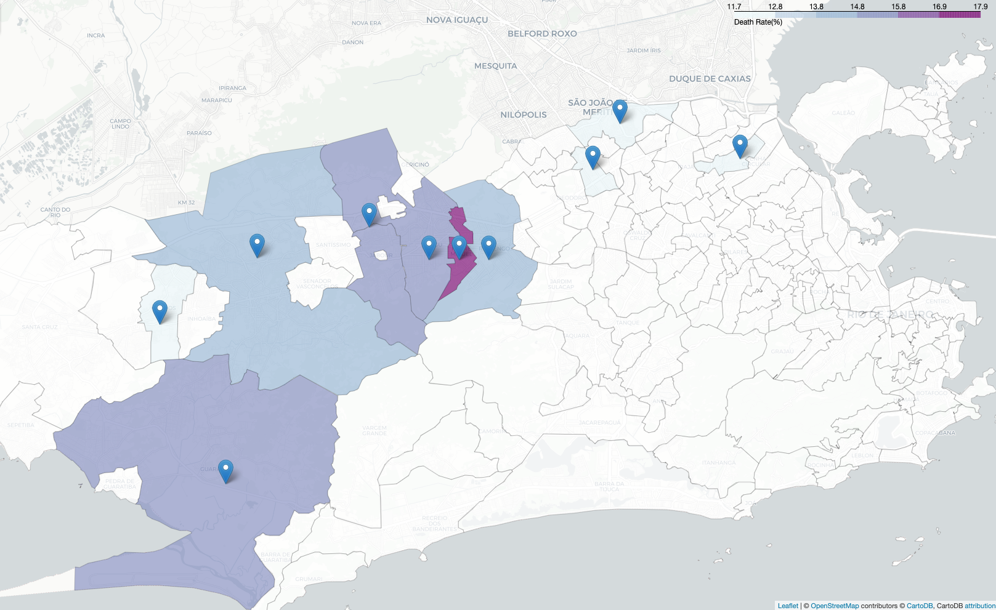
Initial Choropleth Map
Showing the death rate in the top ten neighborhoods

Slide 7
Grouping the clusters after fitting the data
Sorted by Death Rate in descending order

Slide 8
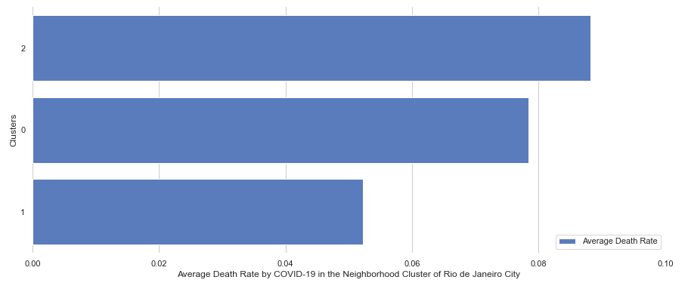
Studying the cluster properties

Slide 9
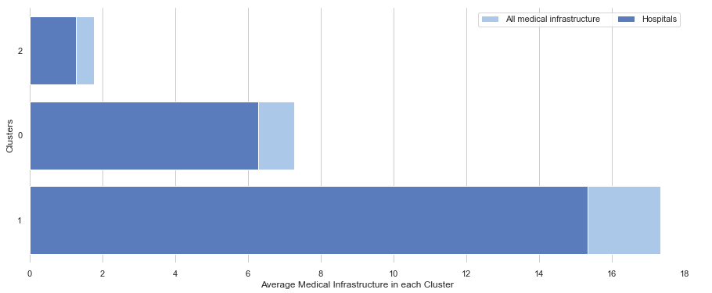
Studying the cluster properties

Slide 10
Results
Cluster 2 has the larger death rate and worst medical infrastructure overall;
Cluster 0 has a medium death rate and average medical infrastructure, with few hospitals;
Cluster 1 has the smallest death rate and best medical infrastructure of all above.
The west zone of the city has the largest death rate by COVID-19. It consists of several neighborhoods, such as Campo Grande, Bangu, Realengo, Padre Miguel and many others.

Slide 11
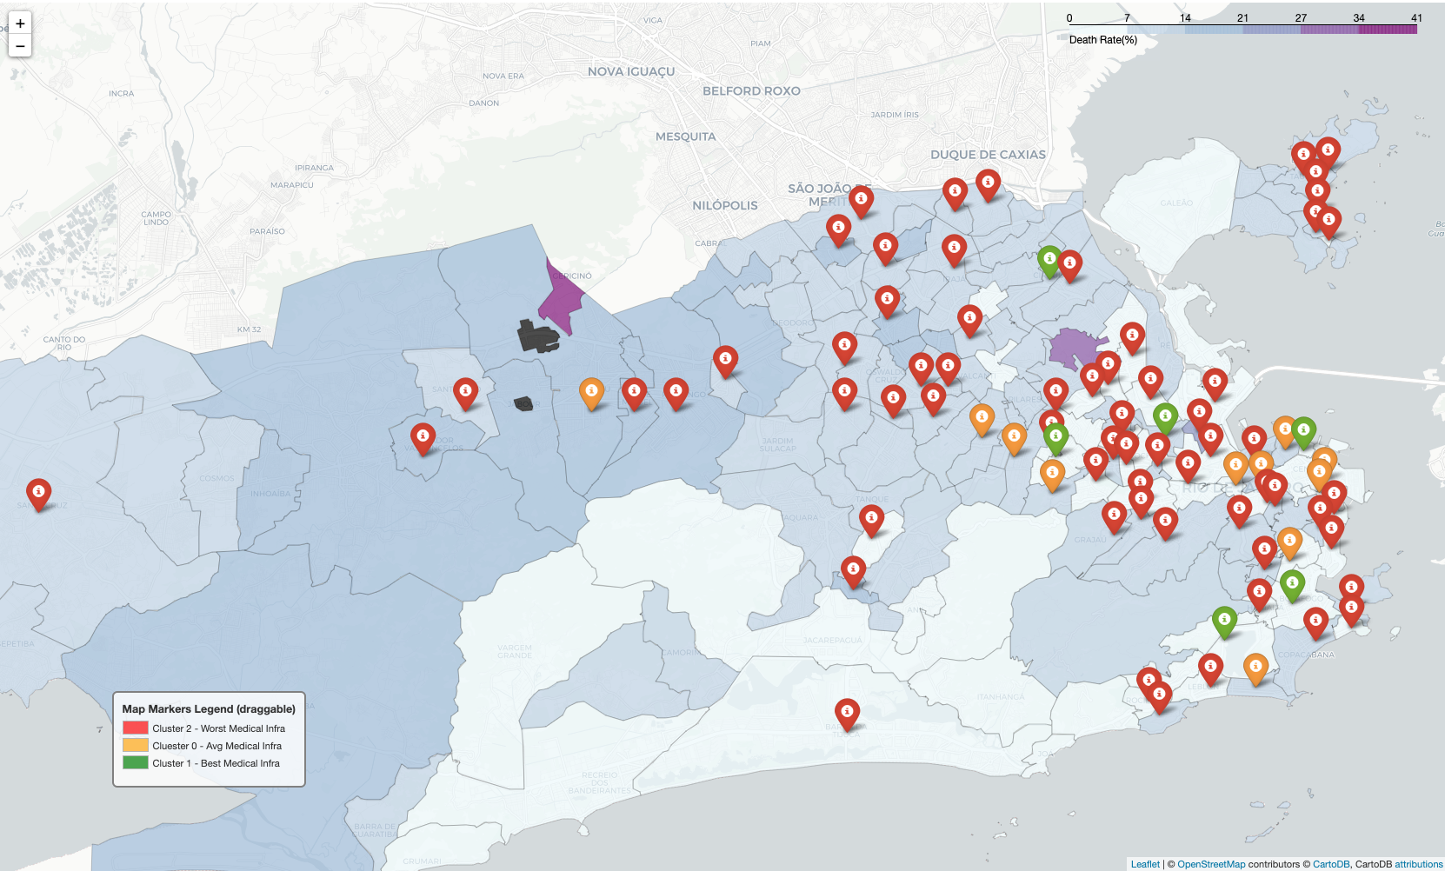
Final Choropleth Map
Clusters distribution

Slide 12
Conclusion
many of the light-colored areas (low death rate) with bad medical infrastructure have low demographic density, such as Vargem Grande and Jacarepagua (areas with vast chunks of native rainforest), Galeao (the intl airport of Rio) and Cidade Universitaria (the region where the Federal University of Rio is situated);
All the west area of the city, places such as Padre Miguel, Senador Camara, Senador Vasconcelos, Campo Grande (the most populous neighborhood) and some others, support the results of the study since these are regions with high death rate and lacks medical infrastructure of all kinds.
The best neighborhoods to live (part of cluster 1, in areas with low death rate) should be: Jardim Botânico, Botafogo, Saude and Meier.

